Slide 1
Test Design Techniques
September 2014
Andrii Artysh
January 2016

Slide 2

Agenda
Equivalence partitioning and Boundary value
Decision tables
State transition

Slide 3
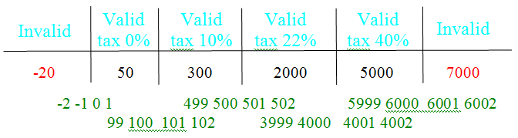
Equivalence Partitioning and Boundary Values
Condition : In a system designed to work out the tax to be paid: An employee has $1000 of salary tax free. The next $500 is taxed at 10%. The next $4000 is taxed at 22%. Any further amount is taxed by 40%. Salary cannot be larger than $6000.
Description :
Equivalence partitioning values – black(Valid) and red (Invalid) values
Boundary values – green values

Slide 4
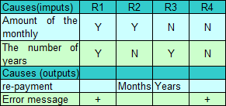
Decision Tables
Condition : You take a loan in a bank. The bank gives you loan application, where you can enter the amount of the monthly re-payment or the number of years you want to take to pay it back (the term of the loan). You should infill only one of the proposed fields. If you enter both, then you will get an error message.
Enter the amount of the monthly re-payment
Enter the number of years
User can infill only one of the proposed fields

Slide 5
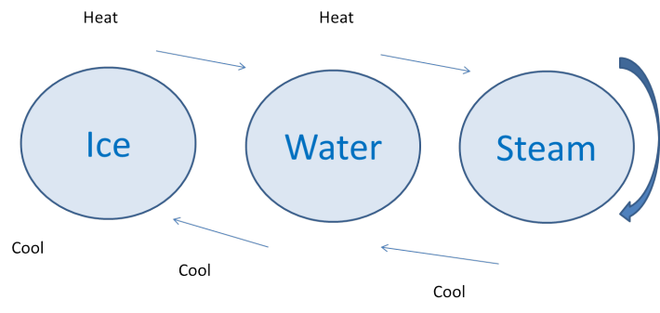
State Transition
Condition : Customer chooses Arabica coffee from coffee machine. He selects specific sort of coffee (in this case Arabica), and enters money. If not enough money is entered, then machine will ask to enter more. If amount of money is ok, then machine will start doing coffee. If Arabica coffee is available, then customer will get coffee and his change in a minute. If there is no selected sort of coffee, then customer will get proper message and his money back.

Slide 6
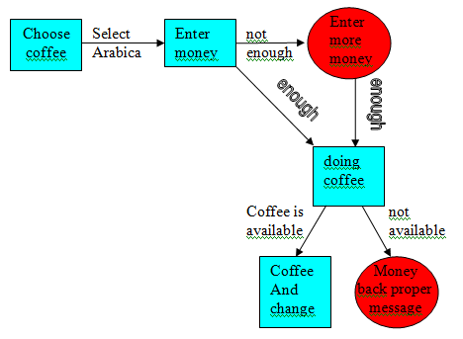
State transition diagram
- Positive scenario - Negative scenario

Slide 7
Thank you
US OFFICES
Austin, TX
Fort Myers, FL
Boston, MA
Newport Beach, CA
Salt Lake City, UT
EUROPE OFFICES
United Kingdom
Germany
The Netherlands
Ukraine
Bulgaria
EMAIL
info@softserveinc.com
WEBSITE:
www.softserveinc.com
USA TELEPHONE
Toll-Free: 866.687.3588
Office: 239.690.3111
UK TELEPHONE
Tel: 0207.544.8414
GERMAN TELEPHONE
Tel: 0692.602.5857

